Slide 1
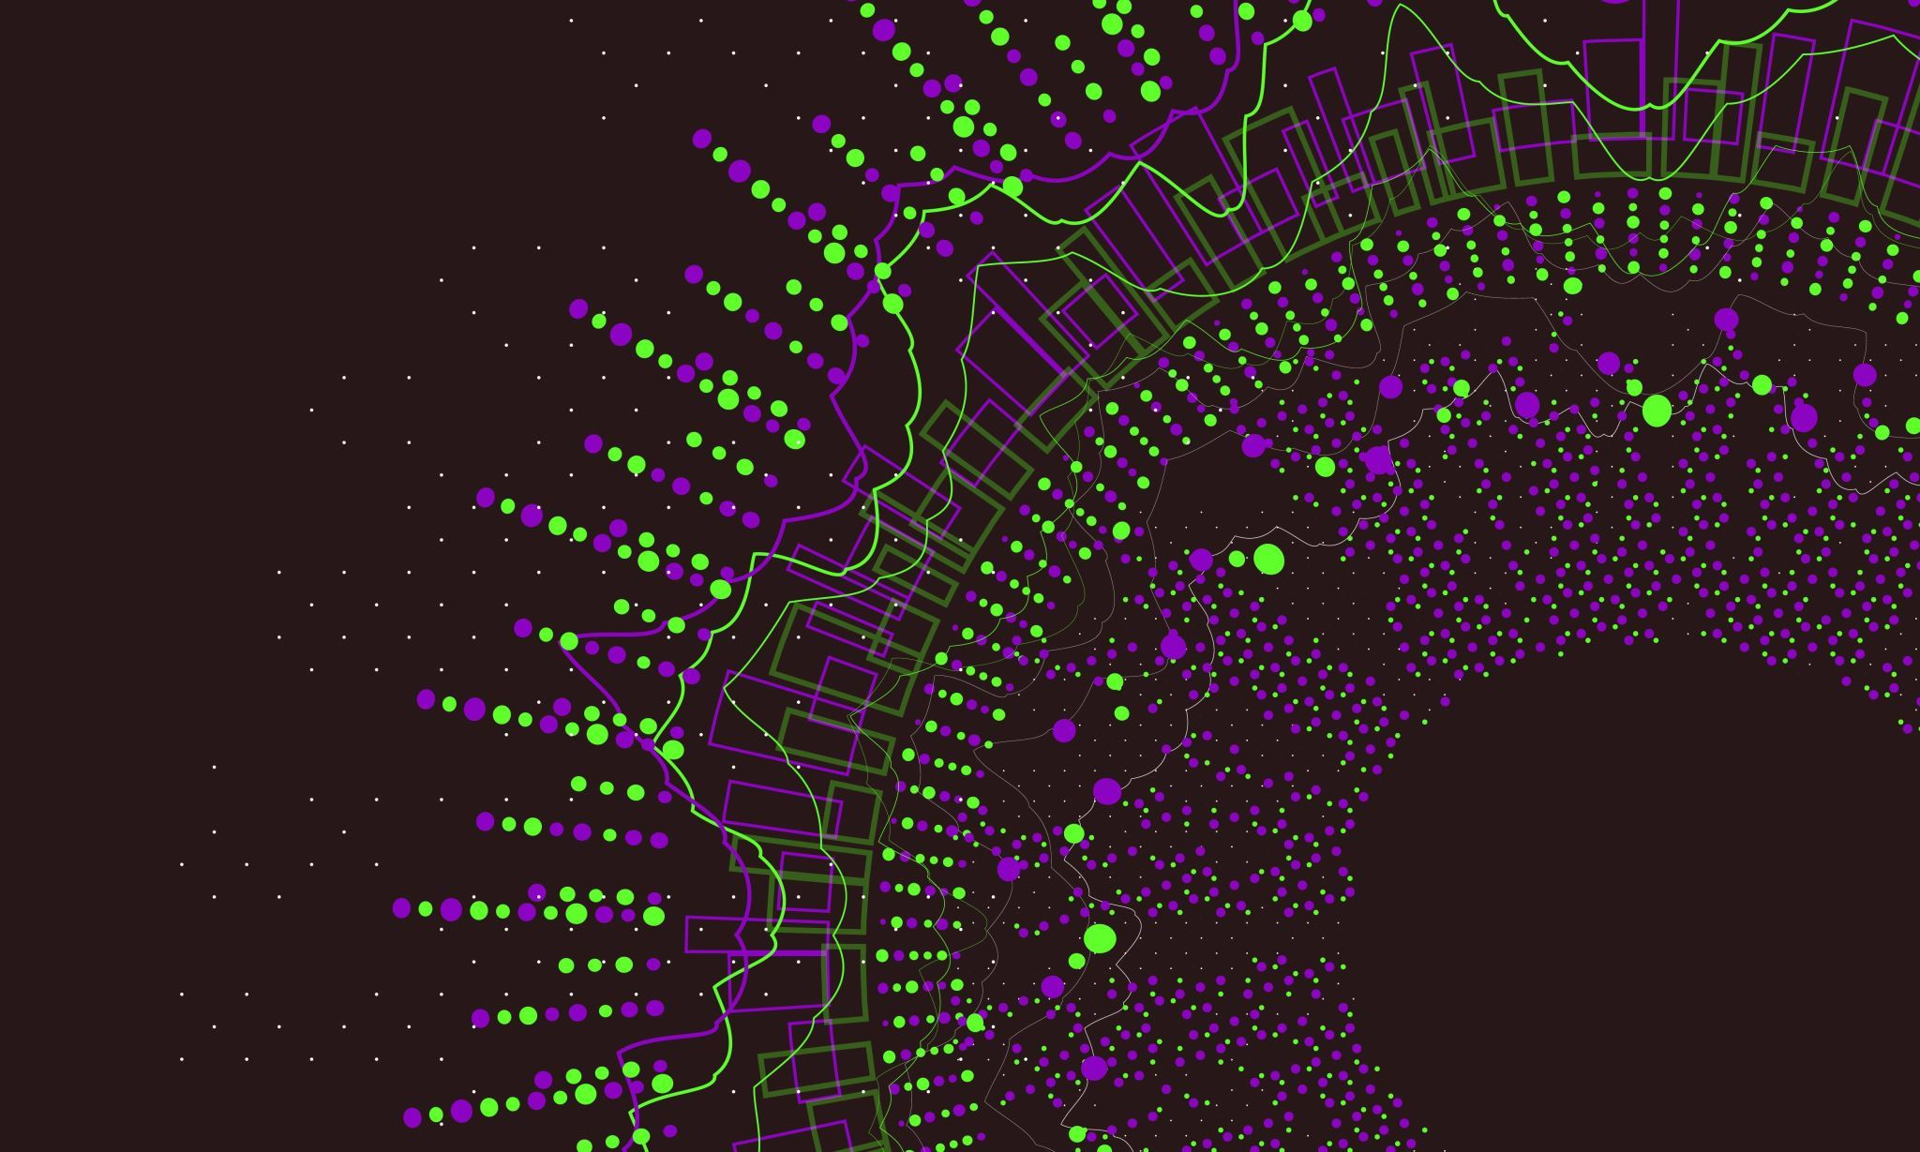
XGBOOST ALGORITHM
REGRESSION

Slide 2
EXTREME GRADIENT BOOSTING
(XG BOOST)
Extreme Gradient Boosting (XG Boost) is an open-source library that provides an efficient and effective implementation of the gradient boosting algorithm.
Gradient boosting algorithm works by sequentially training models where each new model tries to correct the errors made by its predecessor.
In gradient boosting each new model is trained to minimize the loss function such as mean squared error or cross-entropy of the previous model using gradient descent

Slide 3
DIAGRAM
DATASET
D₁
D₂
D_{n}
Tree 1
Tree 2
Tree N
residual
residual
---------
Prediction
W₁
Prediction
W₂
Prediction
W_{n}
Summation
Final Output

Slide 4
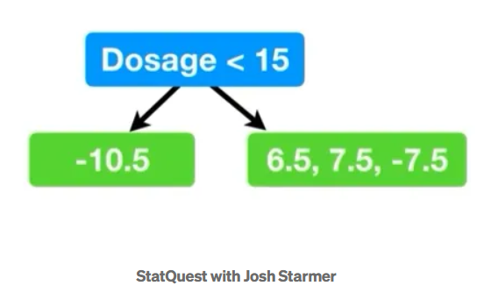
WORKFLOW
Make Initial Prediction and calculate the residual value
Default prediction value: 0.5
Residual = Actual-Predicted
Building the first decision tree
Drug Dosage(mg) | Drug Effectiveness | Residual
10 | -10 | -10.5
20 | 7 | 6.5
25 | 8 | 7.5
35 | -7 | -7.5
Note: We got the Dosage<15 by taking avg of the first two lowest dosages((10+20)/2=15)
Image Source:
statquest with Josh Starmer

Slide 5
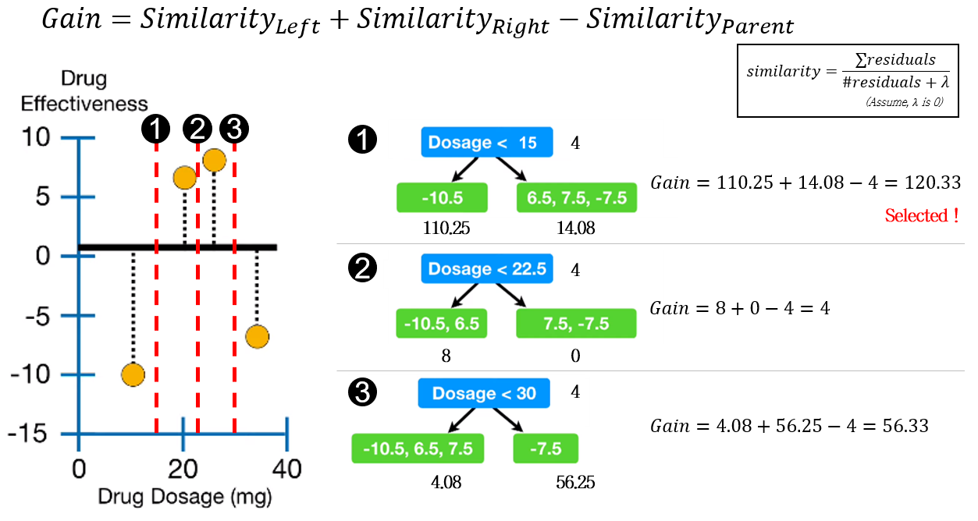
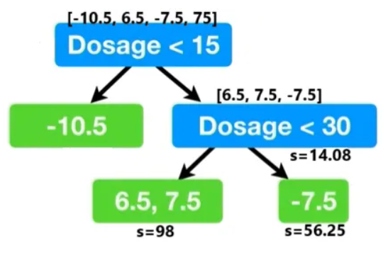
Calculate Similarity score and gain
Split the residuals on the right by repeating same process as above
Gain of threshold <30 is 140.17(largest gain), so it
is selected
Note: As there is only one residual left on the left
leaf, we cannot split it further.
Note:The threshold Dosage<15 got the largest Gain (120.33) compared to other threshold values, so we will select it for root.
Image Source:
statquest with Josh Starmer
Boosting article_Github

Slide 6
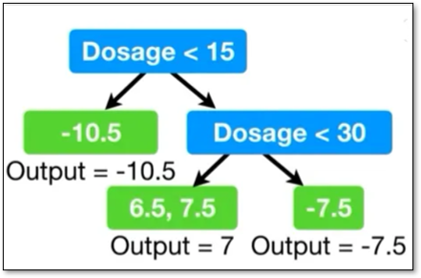

Prune the tree
Compute the output
Calculate the difference between the Gain associated with the lowest branch in the tree (Gain — gamma)
If the difference is negative, we will remove the branch, otherwise we do not remove the branch (Positive)
Gain = 140.17-130 =10.17
Here we assume gamma as 130
Output values are calculated by the below formula
Image Source
statquest with Josh Starmer
XGboost_median article

Slide 7
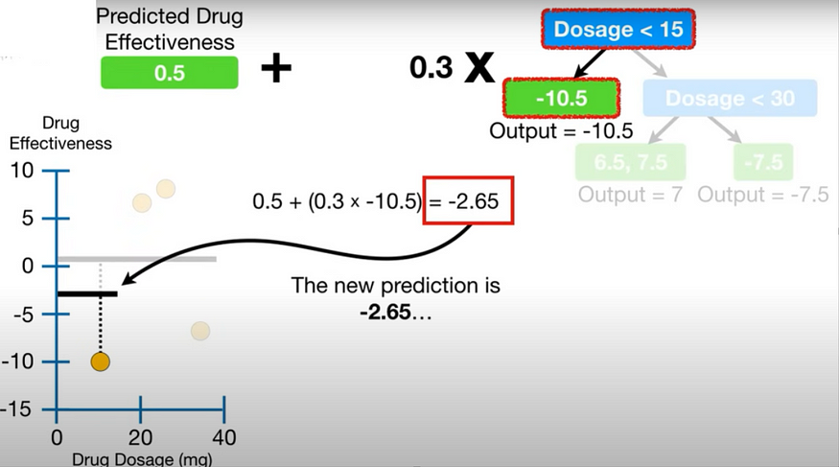
New prediction
New_Prediction=Init_Prediction + learning_rate * First_Tree
New_prediction values are calculated as shown below:
Drug Dosage (mg) | Drug Effectiveness | Residual | New_ Prediction
10 | -10 | -10.5 | -2.65
20 | 7 | 6.5 | 2.6
25 | 8 | 7.5 | 2.6
35 | -7 | -7.5 | -1.75
Next, we will build another tree with new residuals and make a prediction, we keep building trees until the residuals are super small, or we have reached the maximum number.
Here,
Init_Prediction=0.5,
Learning_rate=0.3
Image Source​
statquest with Josh Starmer​
XGboost_median article​
​

